Slide 1



Spatial effort allocation: separation of catches in highly mixed fisheries
Paul J. Dolder, James Thorson, Cóilín Minto,
Jean-Marc Guarini, Dorleta Garcia and Jan Jaap Poos
paul.dolder@gmit.ie

Slide 2
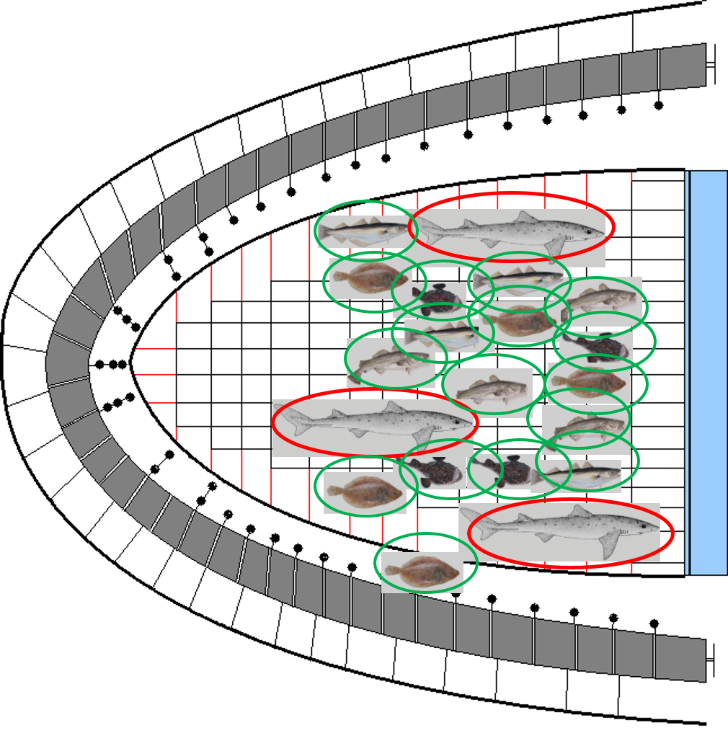
Motivation
Mixed fisheries have highly complex spatiotemporal dynamics
Fishers make decisions about location choice in face of uncertainty
In EU, ‘landing obligation’ makes spatial targeting (and avoidance) key to meeting management goals
Notes:
Mixed fisheries have highly complex spatiotemporal dynamics: in addition to gear choice changing catch composition, timing and location of fishing activity has a significant impact on catch and catch composition.
Fishers inherently make decisions to maximise catch, under quota this reflects a desire to match catches to available quota – a difficult problem in mixed fisheries, may all the harder due to the fact that this is without perfect knowledge, in the face of uncertainty of heterogenous species distributions.
In the EU, spatial fishing patterns, targeting and avoiding species according to individual quota portfolio has become all the more important as the landing obligation requires fishing to stop when the first quota is reached.

Slide 3
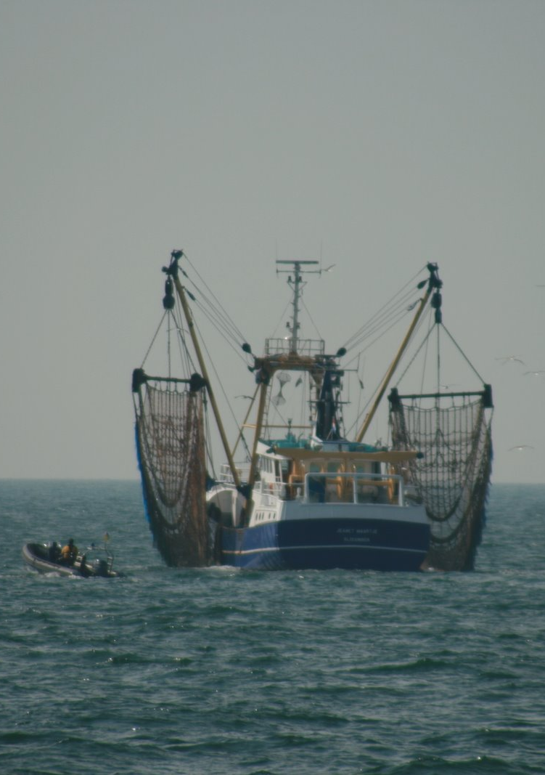
Motivation
Spatial targeting is a mechanism to decouple exploitation among species
Challenge: how far can it practically contribute to dealing with LO
Unknown and anecdotal: need for a quantifiable framework
Notes:
Spatial targeting is one option for decoupling fishing mortality among different species caught in mixed fisheries.
But the extent to how much changing spatial and temporal fishing dynamics can affect catch composition is difficult to quantify. Influenced by many factors that influence species distributions
So difficult to know how far it can go to contribute to the aims of the LO and fishing strategies elsewhere. Need for quantifiable framework to identify where changes in spatial fishing patterns can help….

Slide 4
Objectives
Goal: Develop a framework for understanding and simplifying complexities of spatiotemporal targeting
Approach:
Implement geostatistical model to draw inference on fishery-fish community dynamics
Identify species assemblages which co-occur and are exploited together
Tease out potential for (and limitations to) spatial targeting in mixed fishery
Applied to Celtic Sea case study
Notes:
Goal of this work was to develop a framework that captures the complexities inherent in mixed fisheries, simplify the key interactions and dynamics and identify where spatial targeting can help supports fishers and managers address challenges in balancing activity with quotas.
Implemented a geostatistical model to capture spatial temporal fish community and fishing gear dynamics
Identify key relationships within and among species
Highlight under what circumstances spatial targeting can contribute to balancing quotas in mixed fisheries, what key factors contribute to this end and what limitations exist that might imply other solutions are necessary
Used the Celtic Sea as a case study

Slide 5

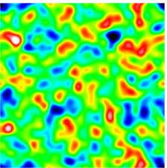
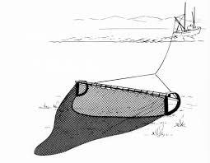
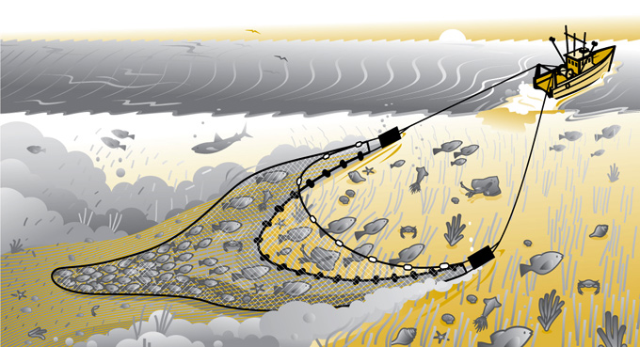
Brief methods
Spatial Dynamic Factor Analysis (SDFA) able to take account of latent (unobserved) drivers which affect species distribution and density for one or more species
Gaussian Markov Random Fields (GMRFs) to model the variation in probability of occurrence and density (and account for autocorrelation)
Separate contribution of gear effects, encounter probability and density (GLMM).
Notes:
Implemented a Joint Dynamic Species Distribution model VAST. Some of you may be familiar with the approach developed by Jim Thorson.
Key features are:
the ability to take account latent drivers of species distributions, and take account of covariance among species in response to these drivers. Do this by capturing spatiotemporal dynamics through spatial and spatiotemporal factors AND species loadings which associate each species with a spatio and spatiotemporal factors
Geostatistical model: Use of Gaussian Markov Random Fields to model spatial autocorrelation through defining a correlation structure
Capture covariance among species, estimate spatiotemporal variation in the probability of encountering a species and the density of a species on encounter.
Separate contributions of gear effects and spatiotemporal effects: set in a linear mixed modelling framework.

Slide 6
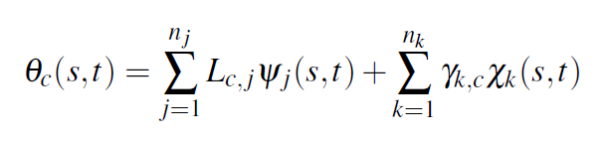
Main interactions
Spp. loading matrix
Density
Covariates
Spatial factor coefficient

Slide 7
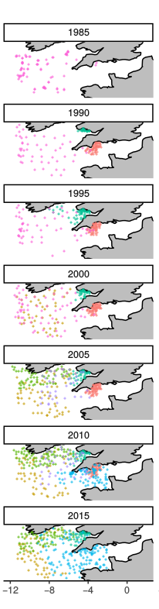
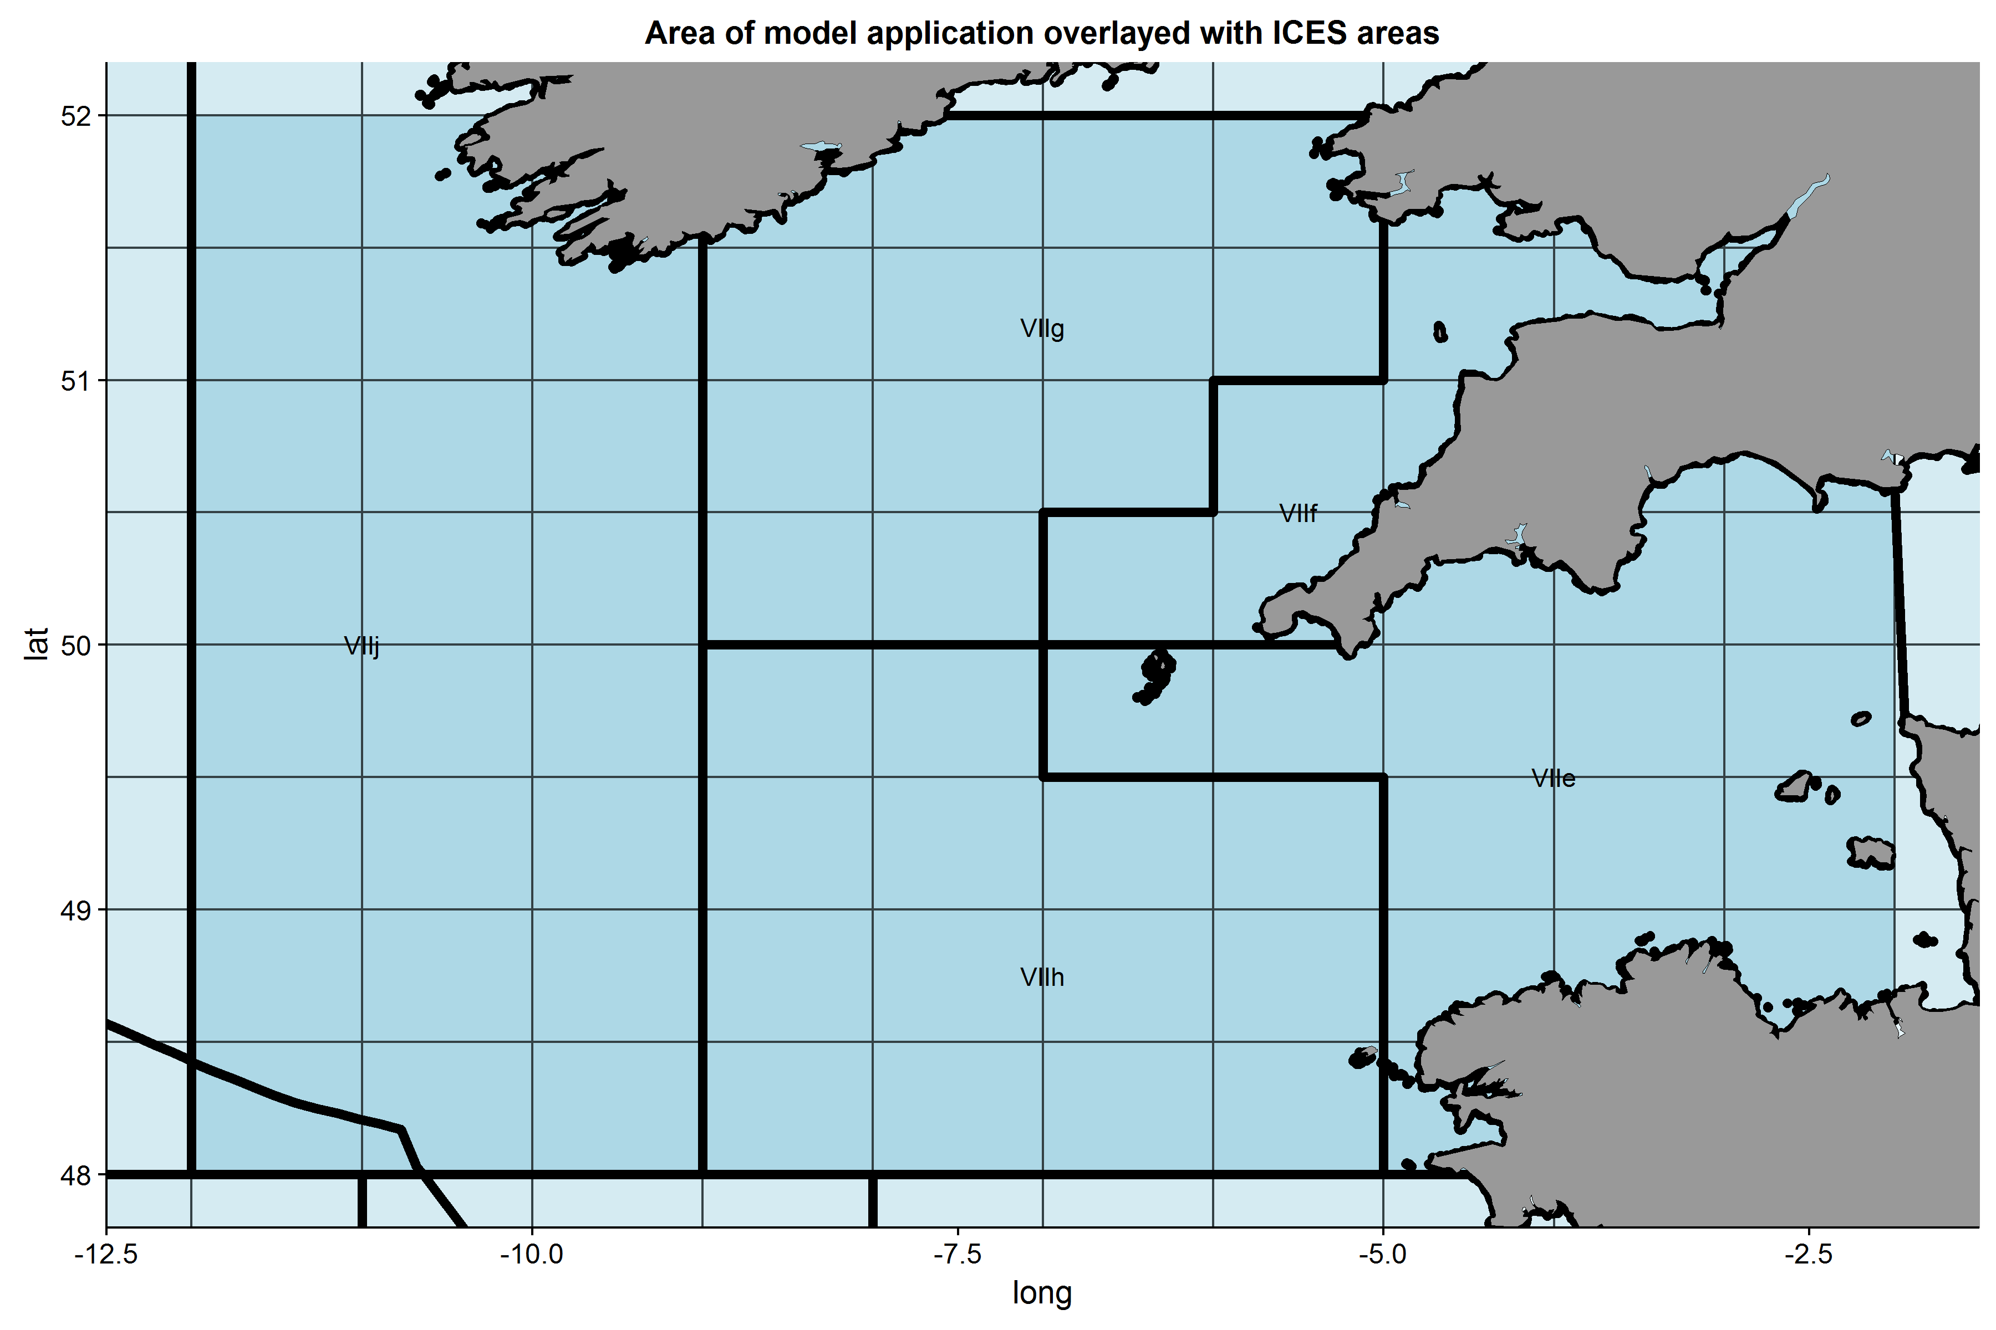
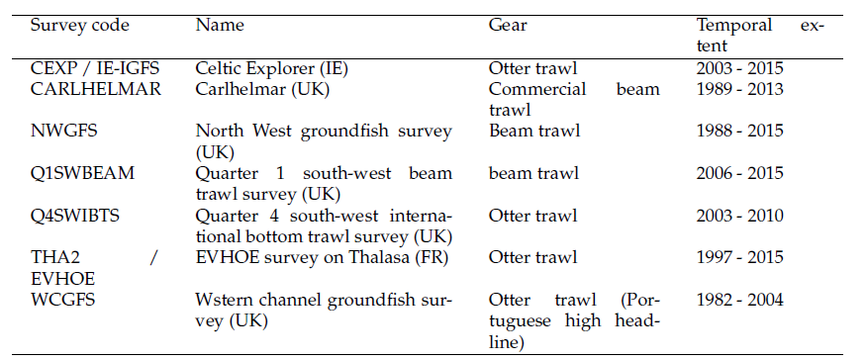
Data: Surveys
Notes:
Data used for the application:
7 different fisheries-independent surveys taking place over the past ~ 25 years in the wider Celtic Sea. For those of you not familiar, this is the sea area between Ireland, UK and France. We considered the wider area covering the Western Channel and further offshore.
As you can see, the spatial coverage has changed over the years, we used data from the period 1990 – 2015 where consistently > 100 stations fished per year

Slide 8
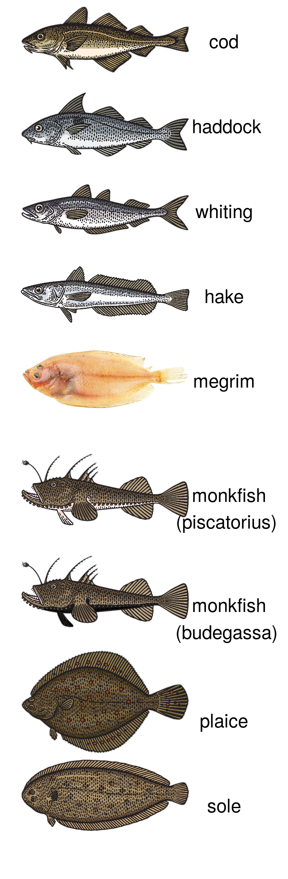
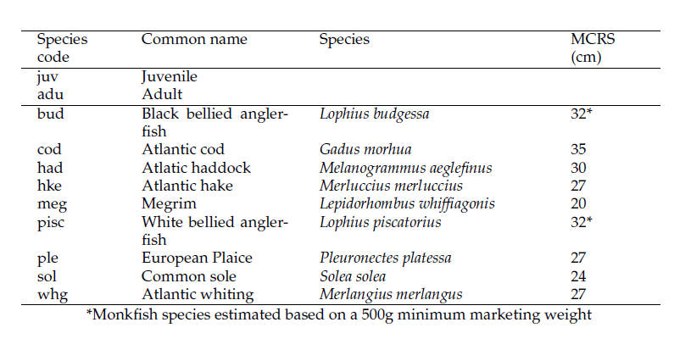
Data: Species
Notes:
Included 9 species, separated these into “adult” and “juvenile” components.
Model fit to 9 factors for each component. So dynamics of the 18 species are described by 9 factors, estimated to explain majority of the variance among species

Slide 9
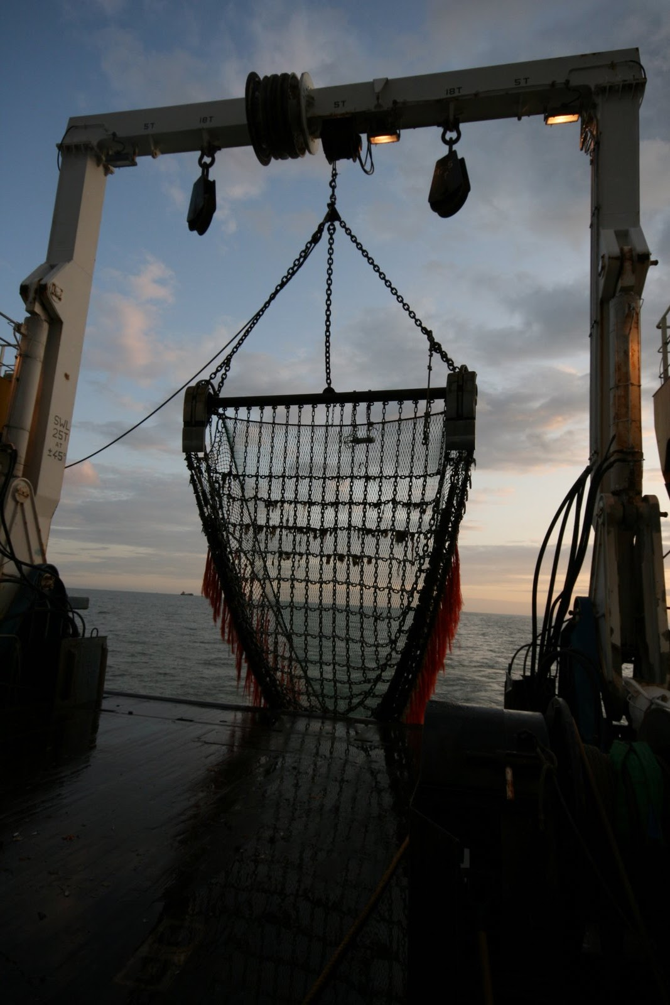
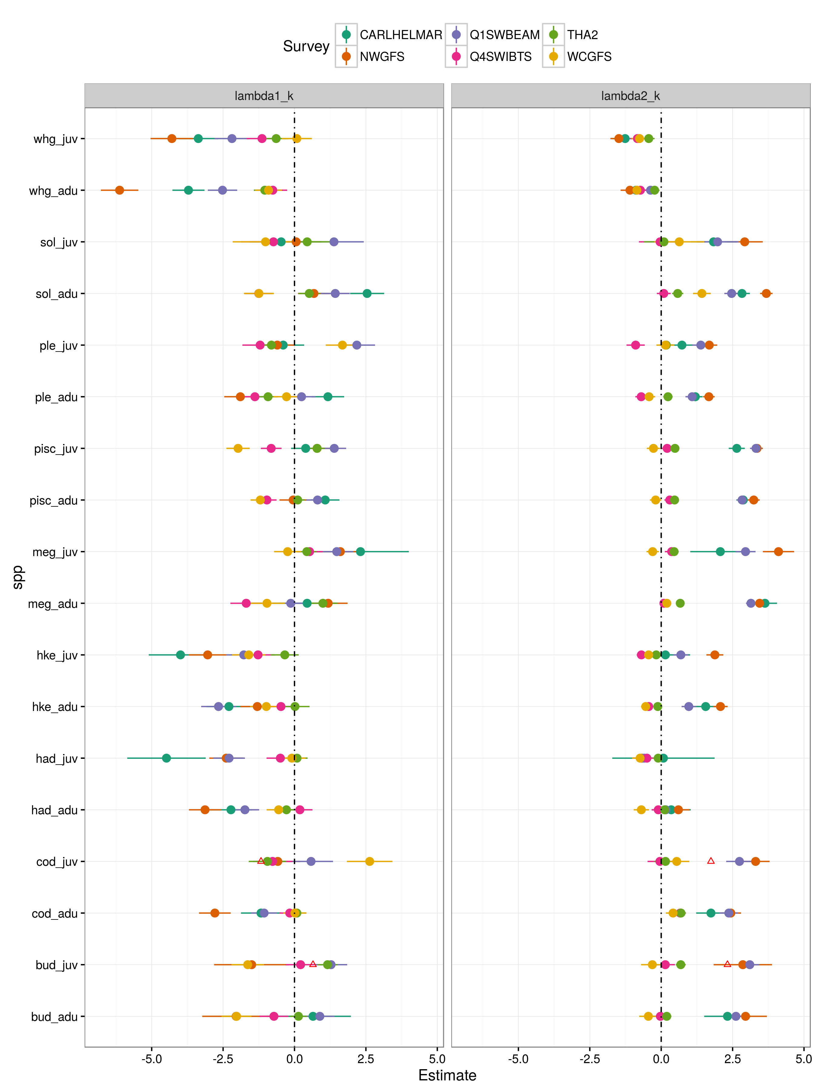
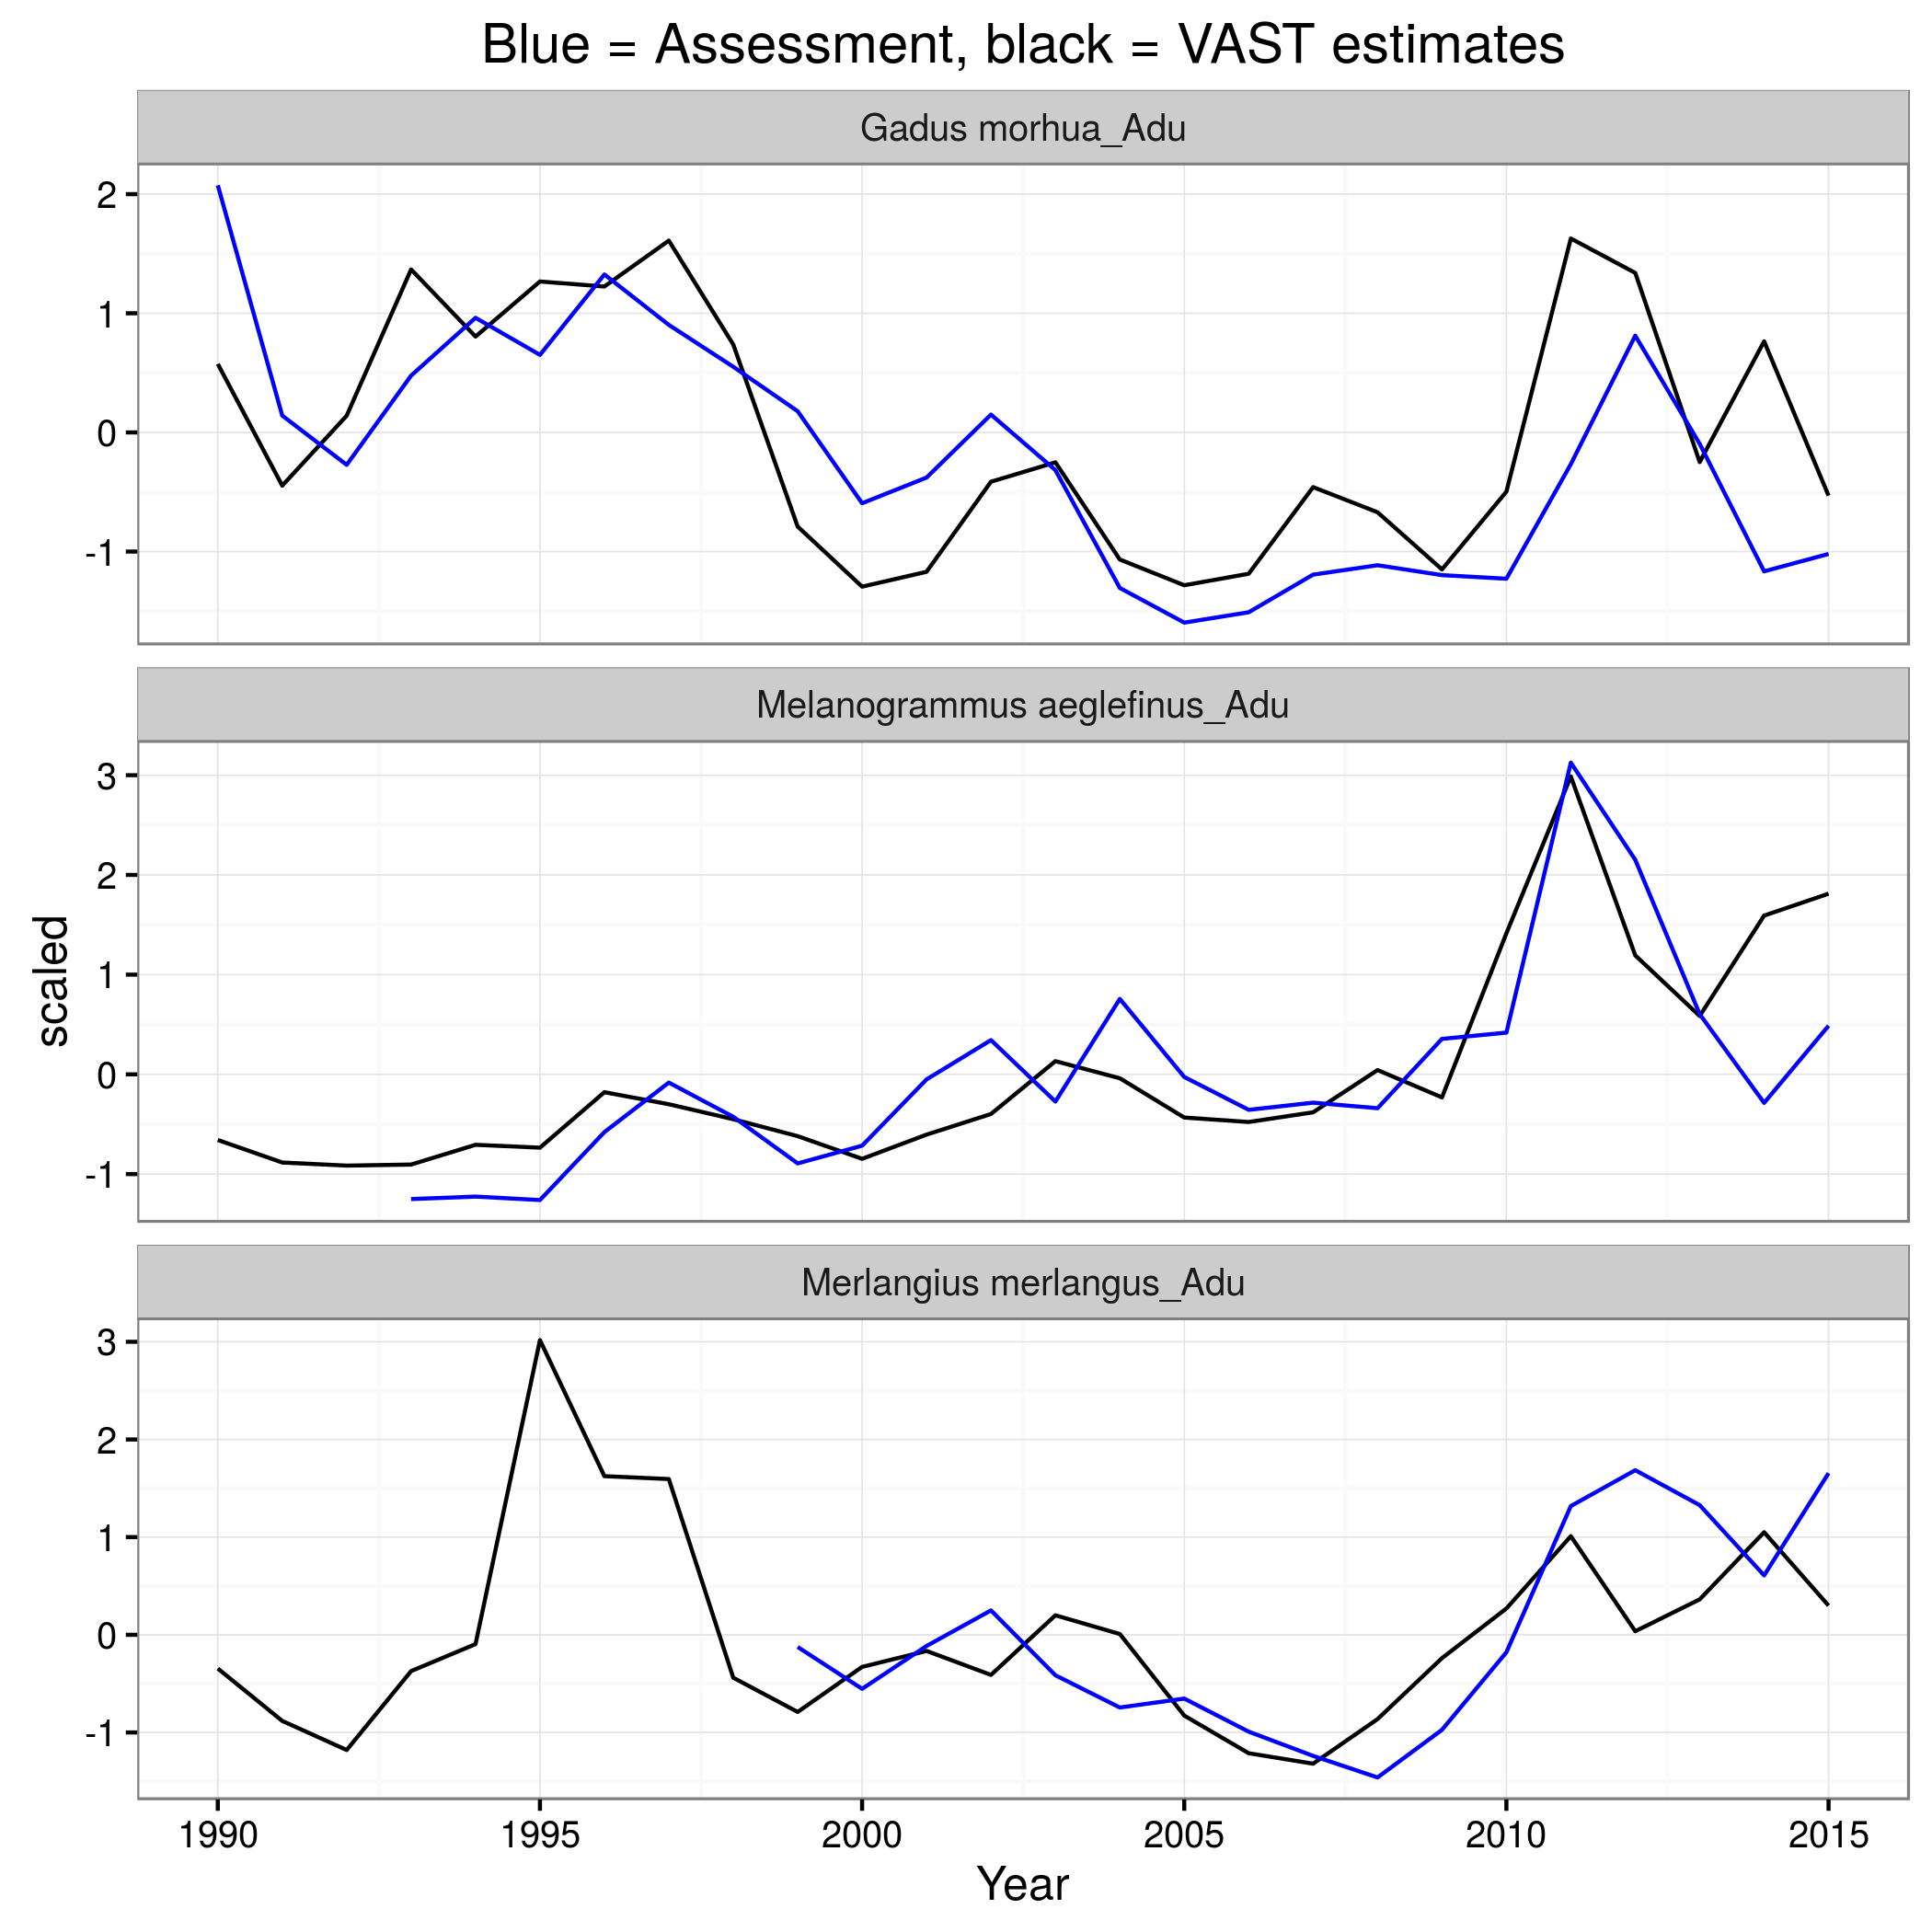
Results
Notes:
Model captures well the temporal dynamics of the populations: example here of the index of abundances for three of the species adult size classes derived from the VAST fit and their respective SSB from the stock assessment. Very good fit.
Here you can see we capture the gear effect on probability of encounter and positive density, taking account of the different survey designs and spatio temporal coverage.

Slide 10
Spatial drivers of species assemblages

Slide 11
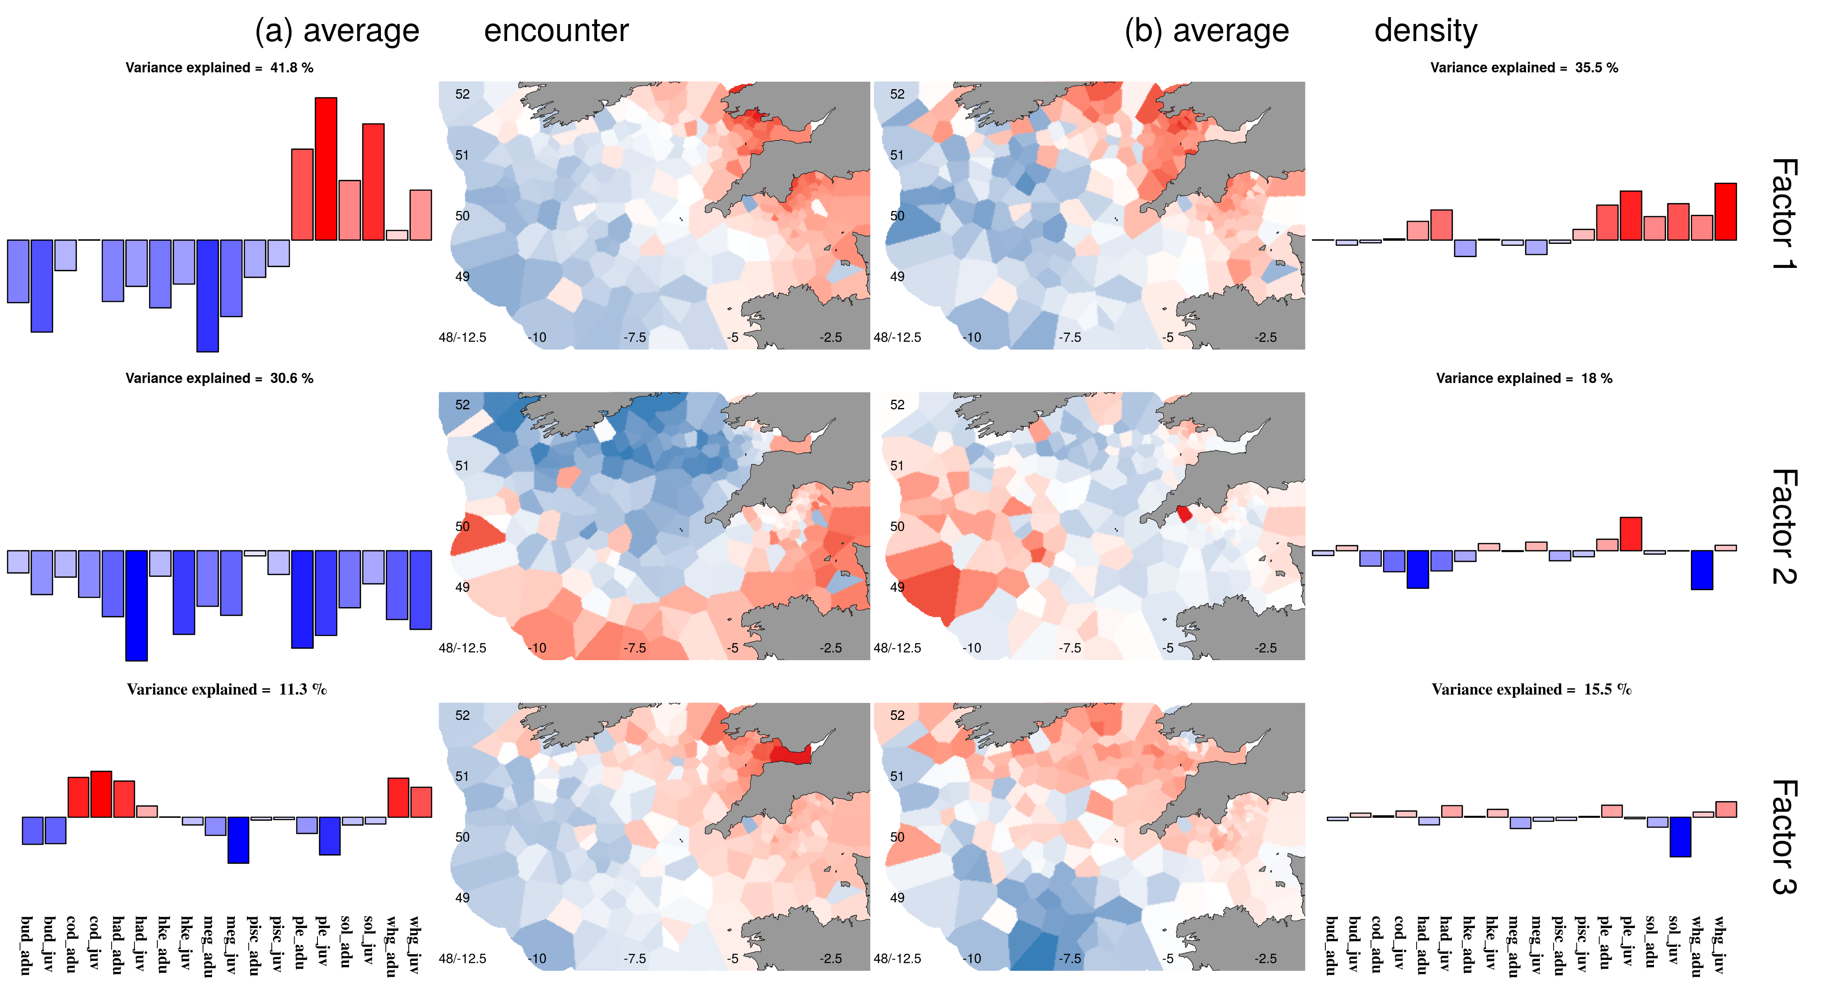
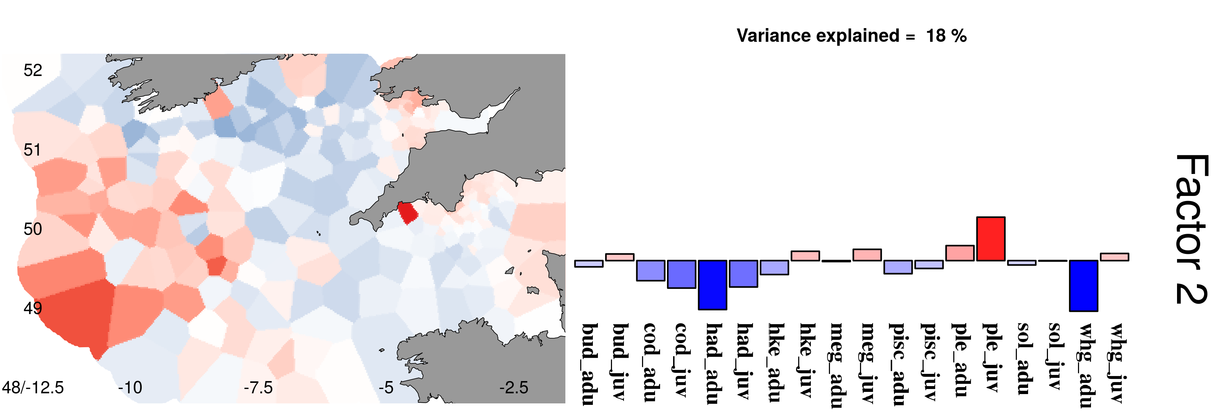
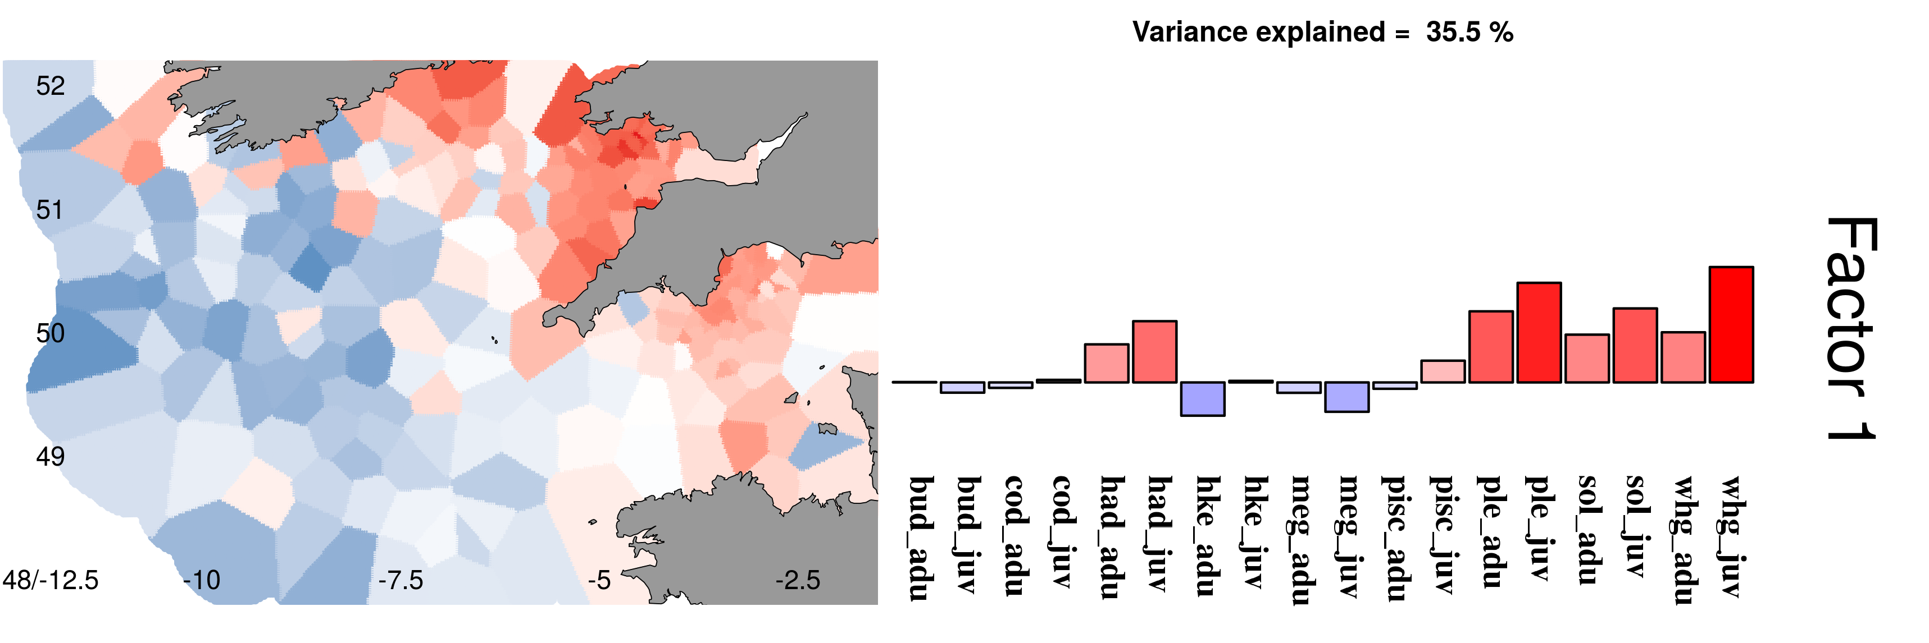
Spatial encounter probability Spatial density
Spatial factor coefficients
Species factor loadings
Spatial factor coefficients
Species factor loadings
Notes:
Figure shows the spatial drivers of species distributions for first 3 factors and how the species load on to these factors. First 3 factors account for 84 % of the species variability for encounter probability and 69 % of the variability in spatial density.
Focus on first two factors of positive density:
Can see that spatial drivers differ in the more onshore areas with a negative coefficient, more offshore positive coefficient.
Plaice, sole, whiting, haddock and juvenile cod positively associated this first factor. Monkfish, hake and megrims negatively associated with the factor.
Second factor: Channel through the middle. Megrim, plaice and some juveniles of species outside the channel. Cod, haddock, whiting and monkfish within the channel.

Slide 12
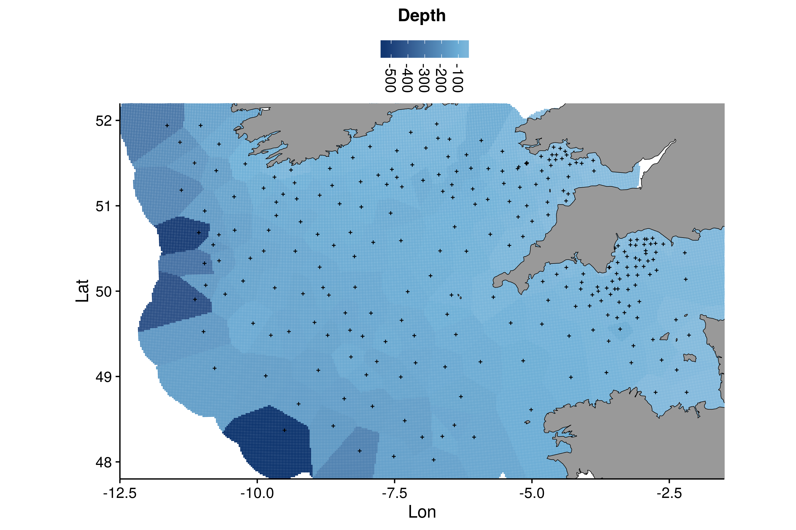
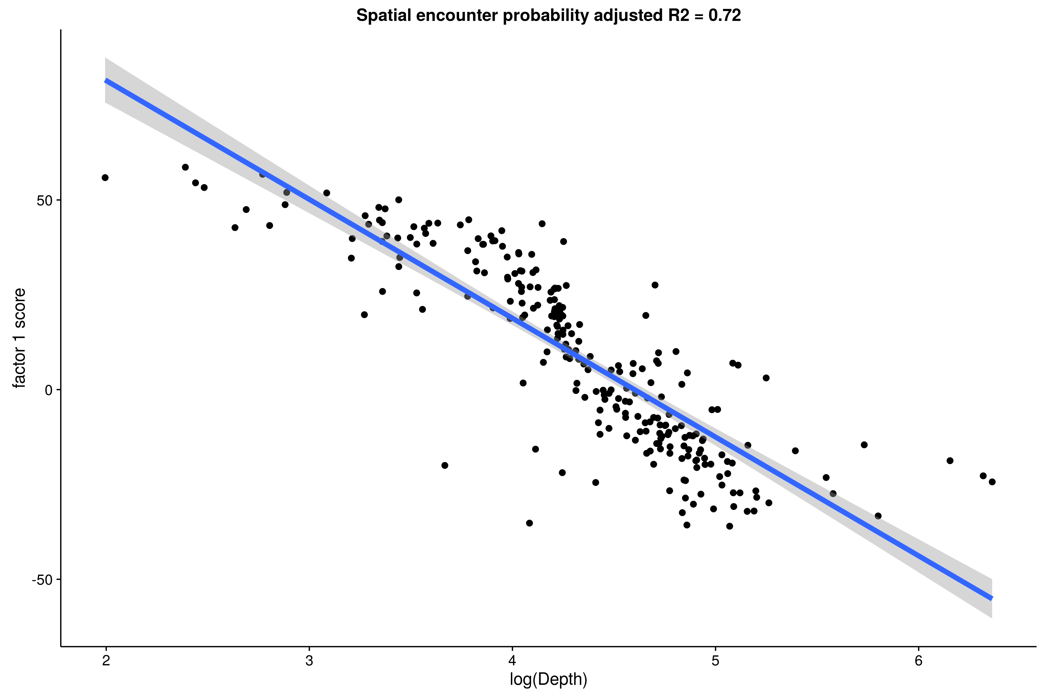
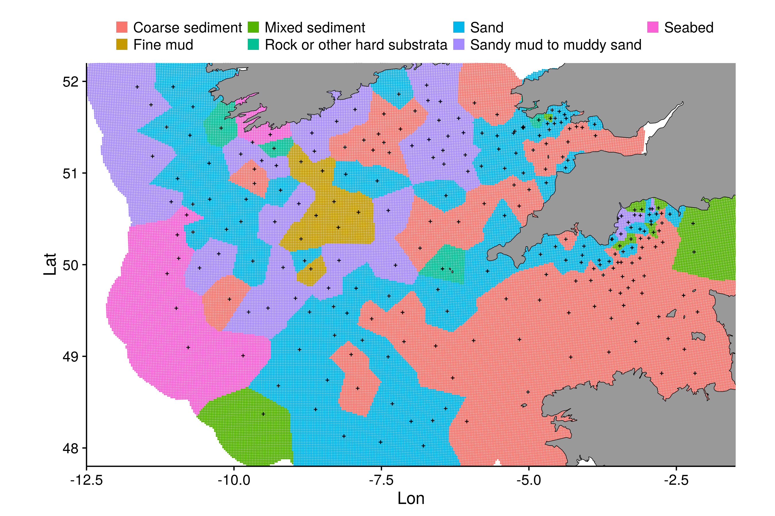
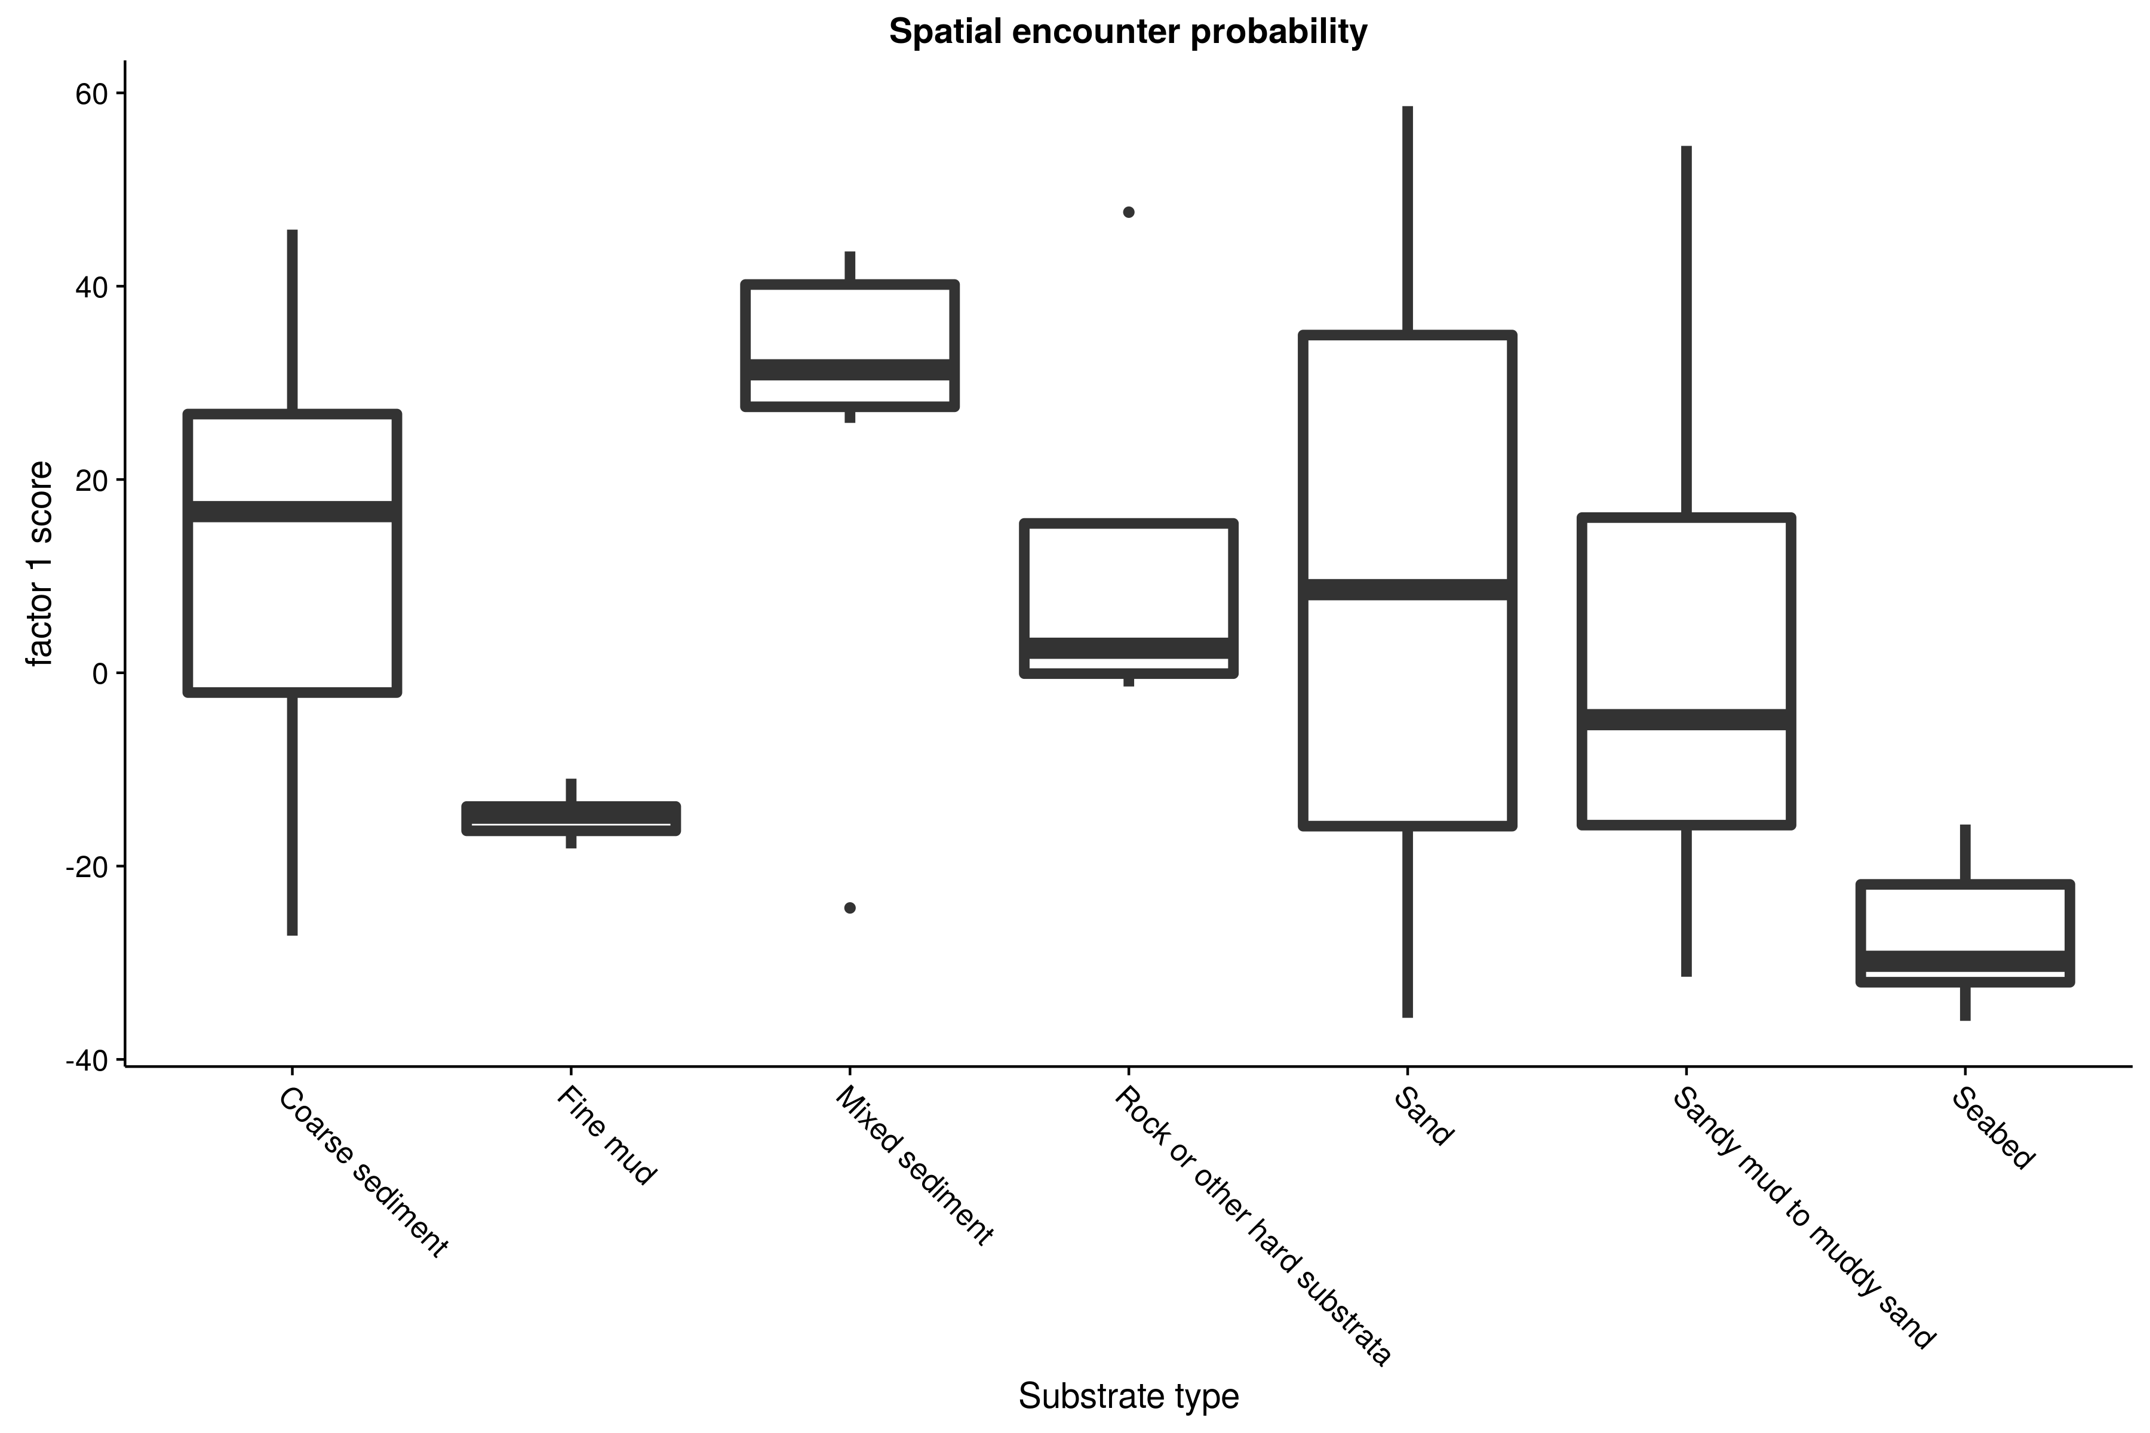
First factor shows strong correlation with depth for encounter probability (-0.85, -0.88 to -0.81) and density (-0.71,
-0.77 to -0.65). 80 % of variance explained by depth and habitat: 9/10 of that by depth.
Notes:
Consider what might be driving these differences.
Strong correlation of the factor coefficients with depth and predominant substrate type for the first factor.
Remember this only the average spatial patterns driving the species distributions.

Slide 13
Spatiotemporal changes in assemblages distributions

Slide 14
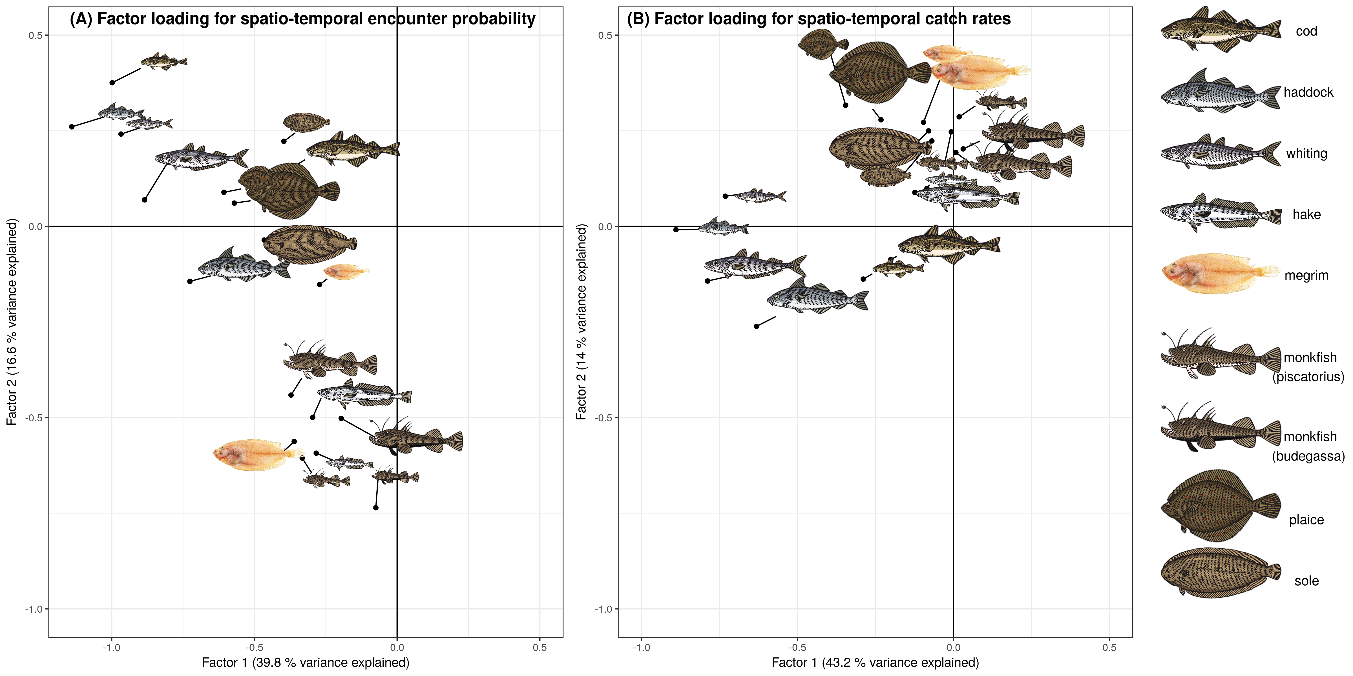
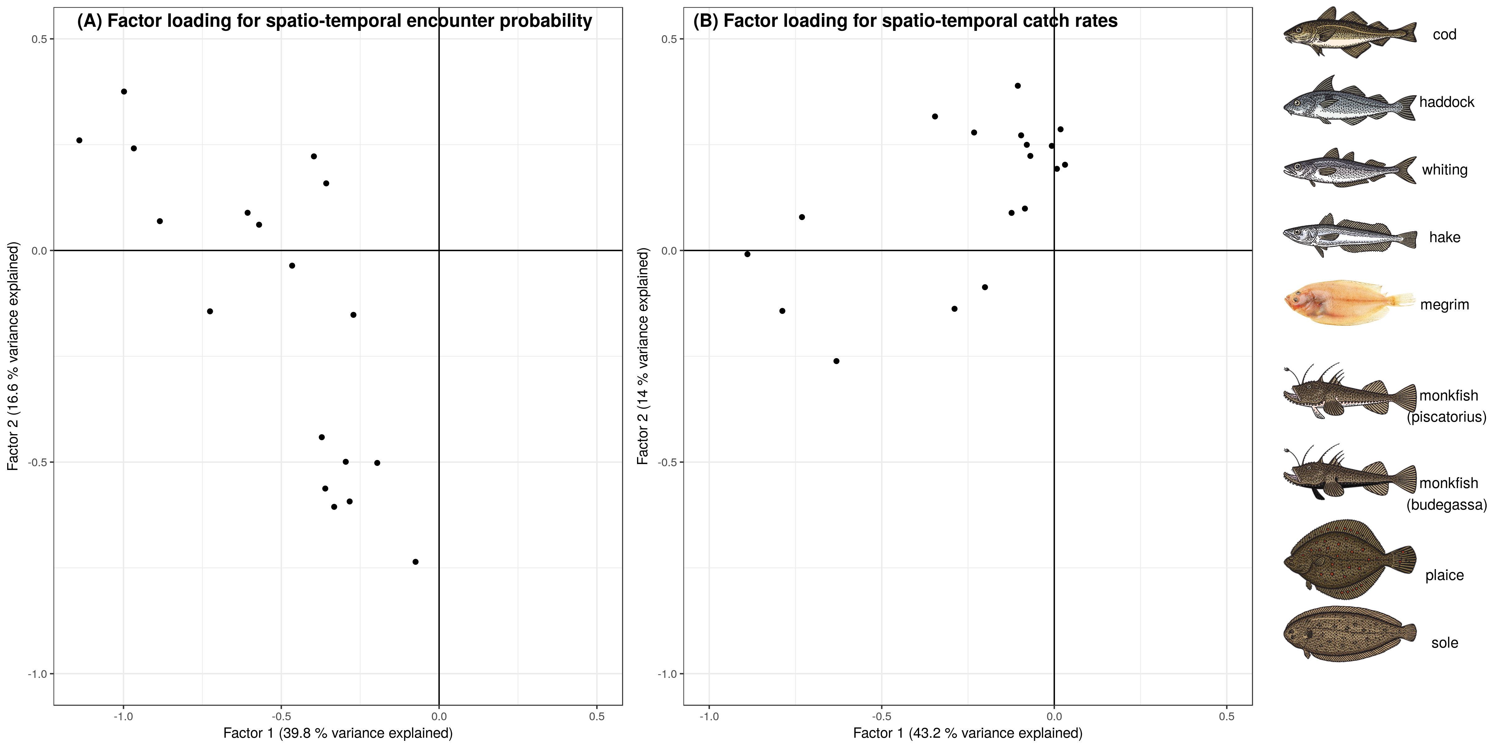
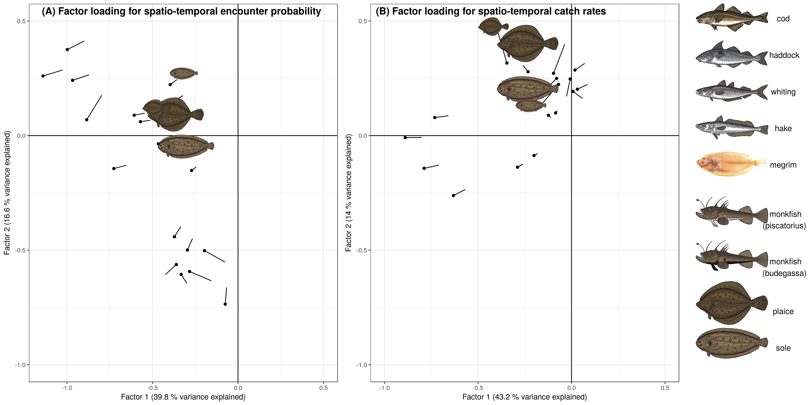
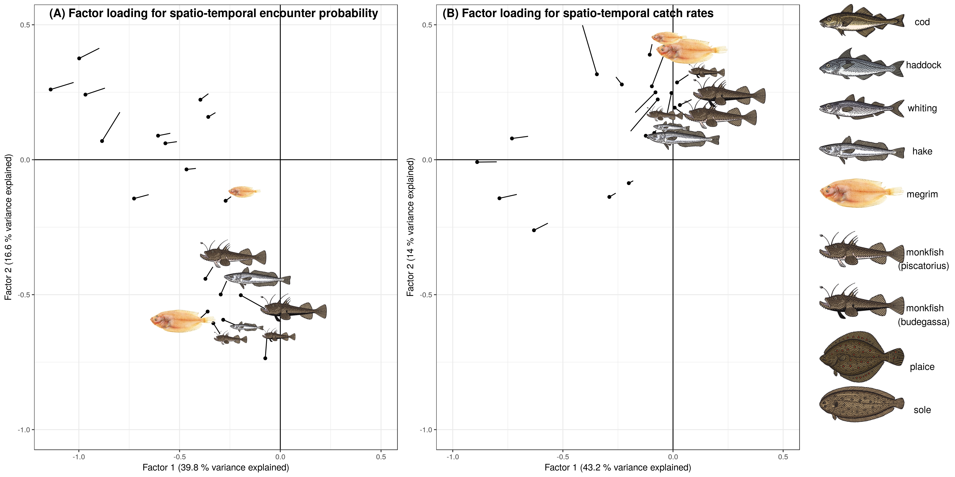
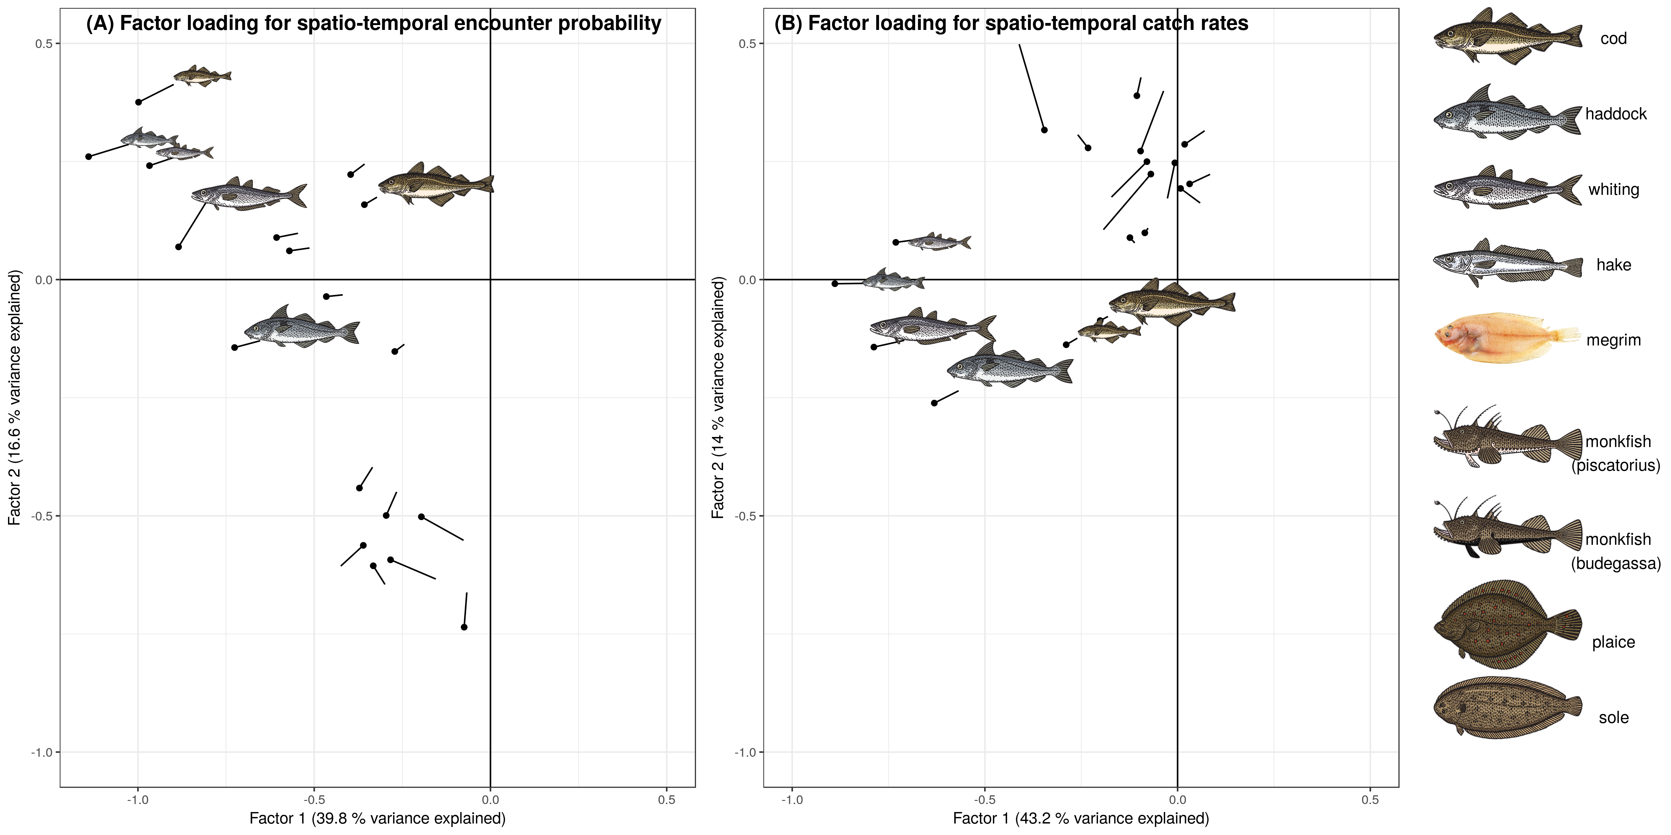
Notes:
Spatiotemporal drivers somewhat more complicated, factor loading spatial patterns change from year-to-year….
BUT:
If we transform the spatiotemporal loading matrices, we get a PCA-type representation of the orthogonal factors explaining the spatiotemporal variances.
We find, the loadings for the species consistently the same for three species assemblages:
Roundfish show similar spatiotemporal dynamics
Flatfish
And Hake, monkfish and megrim: deeper water shelf species

Slide 15
Correlation between species
Notes:
Indeed, when we look at the covariance matrices….

Slide 16
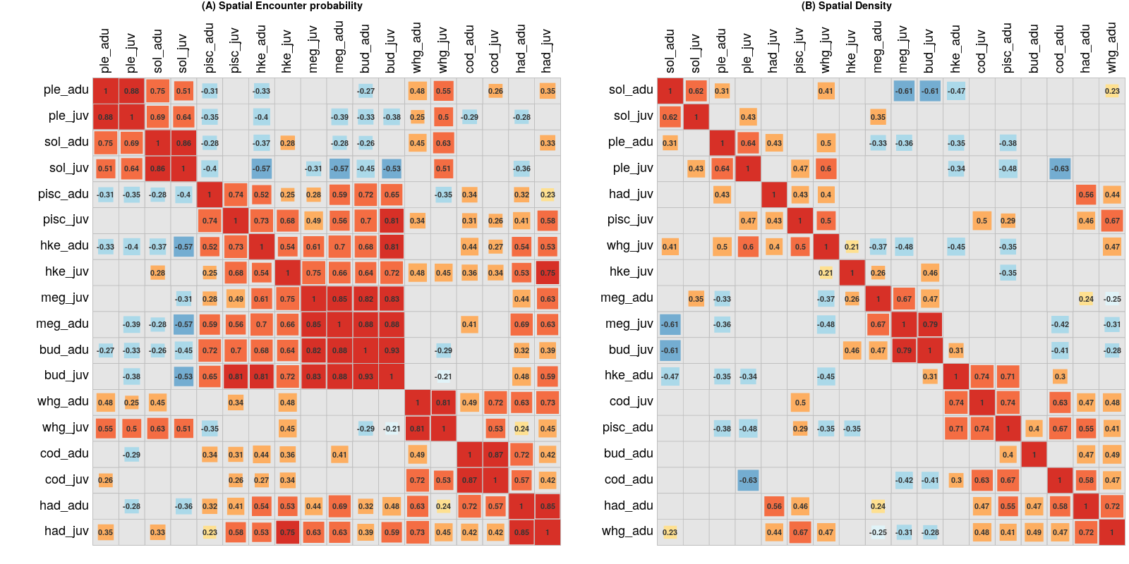
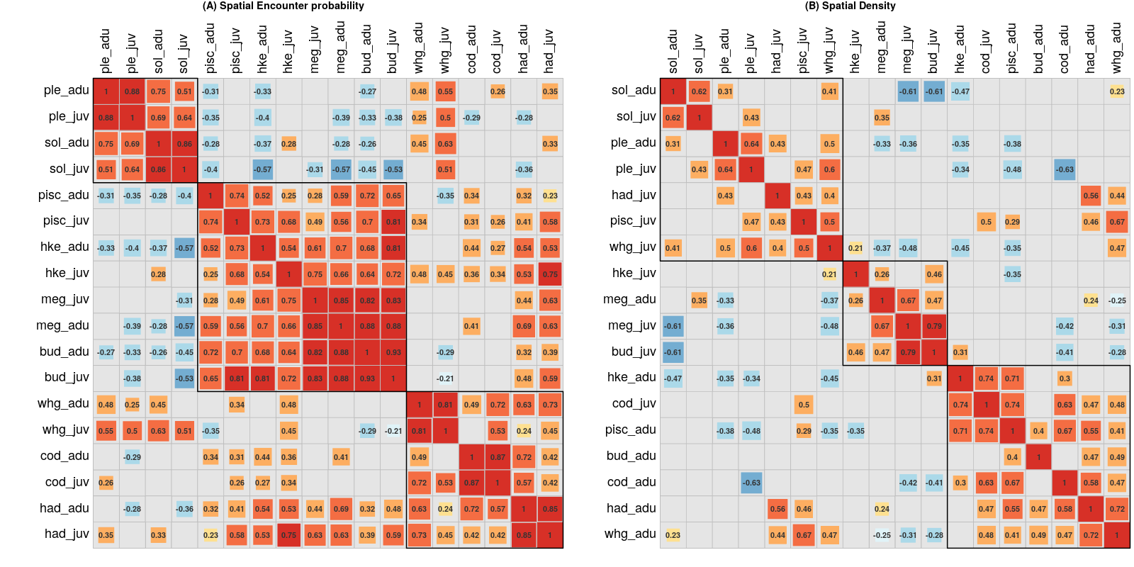
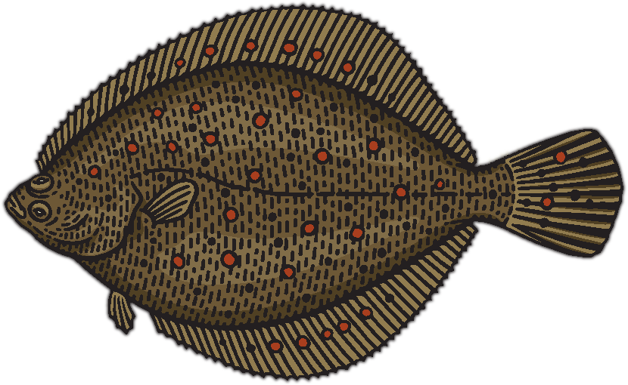
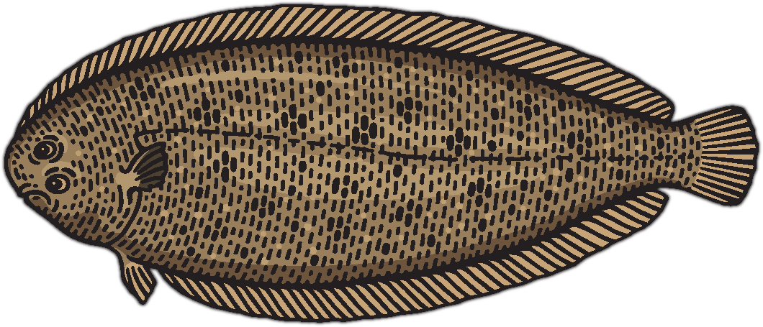
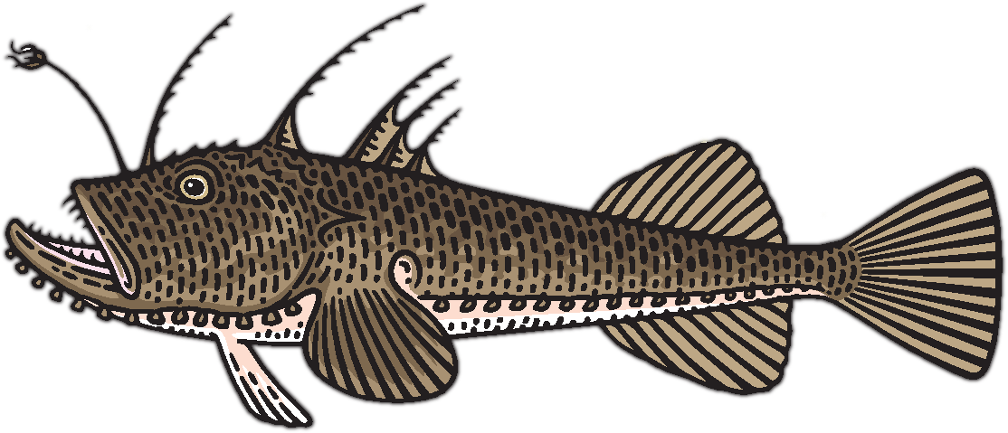
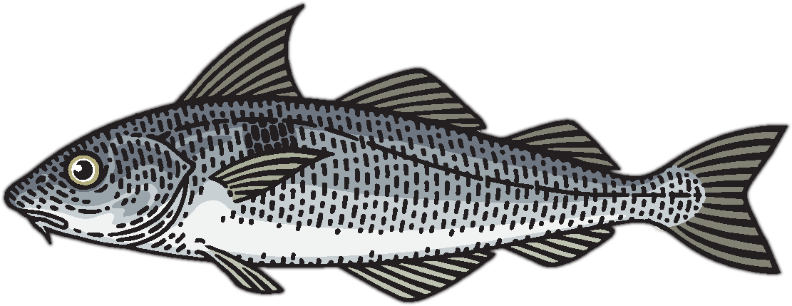
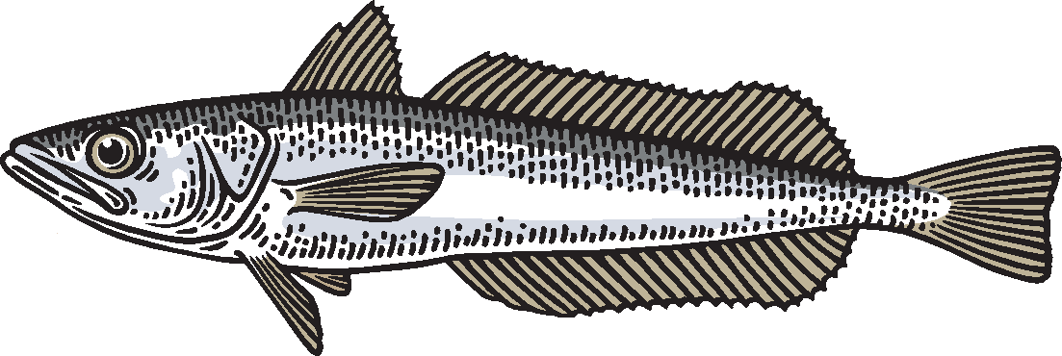
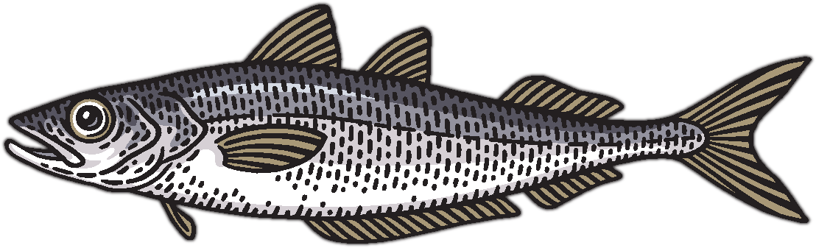
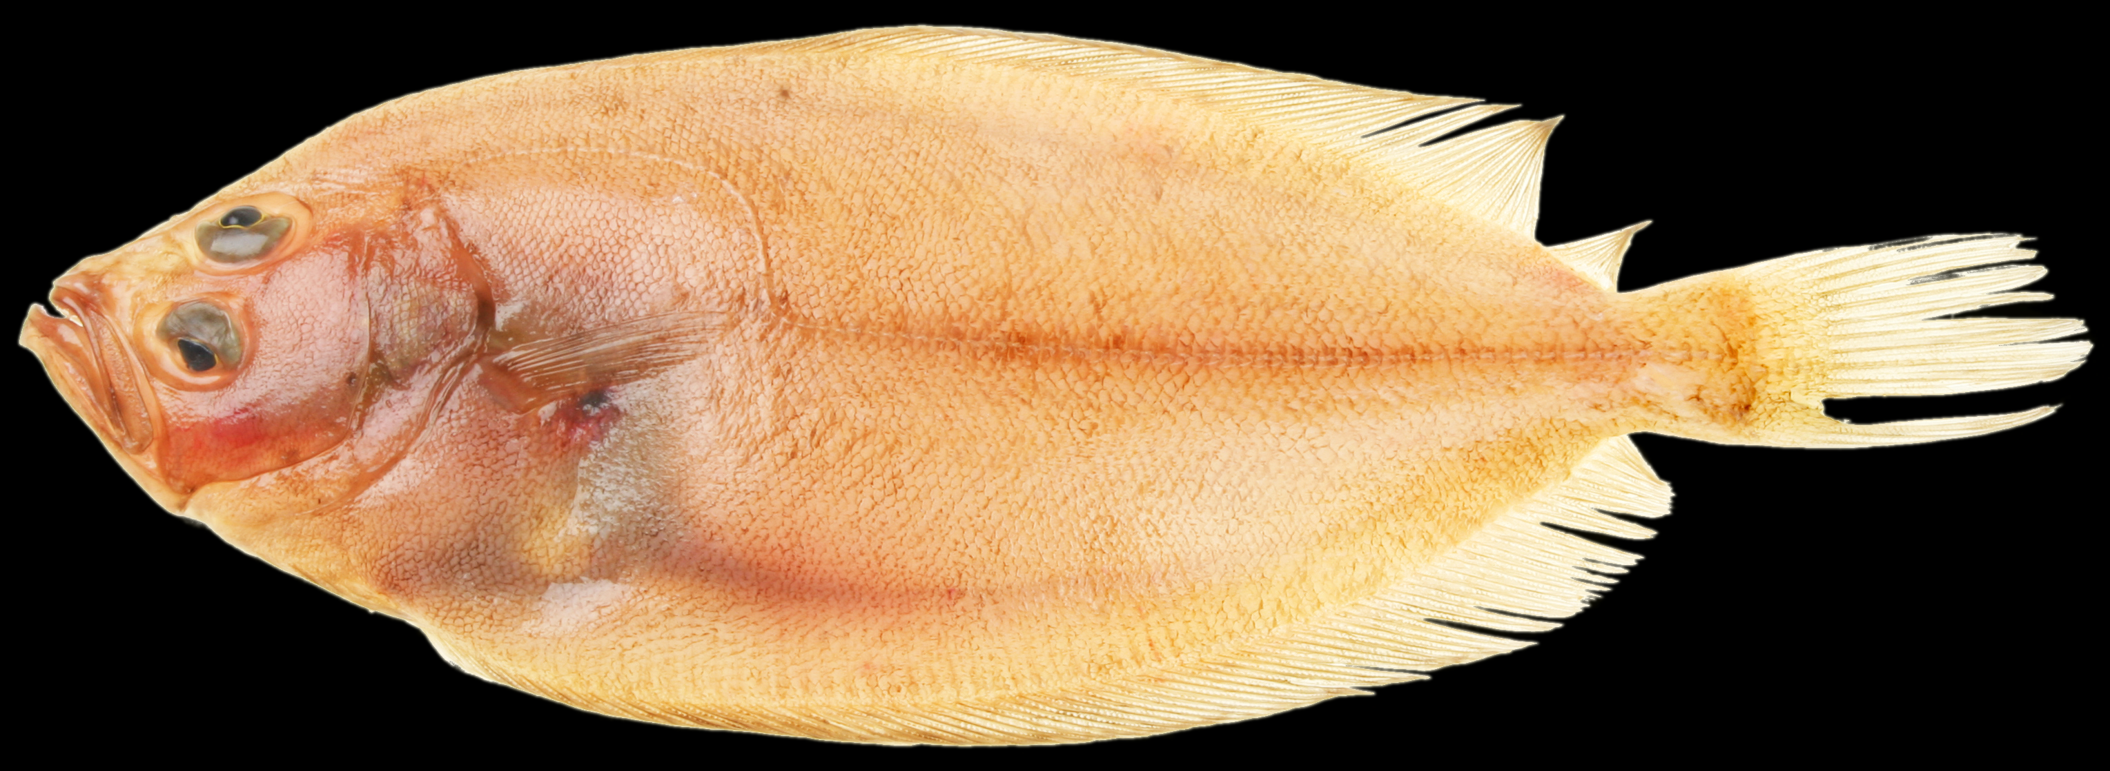
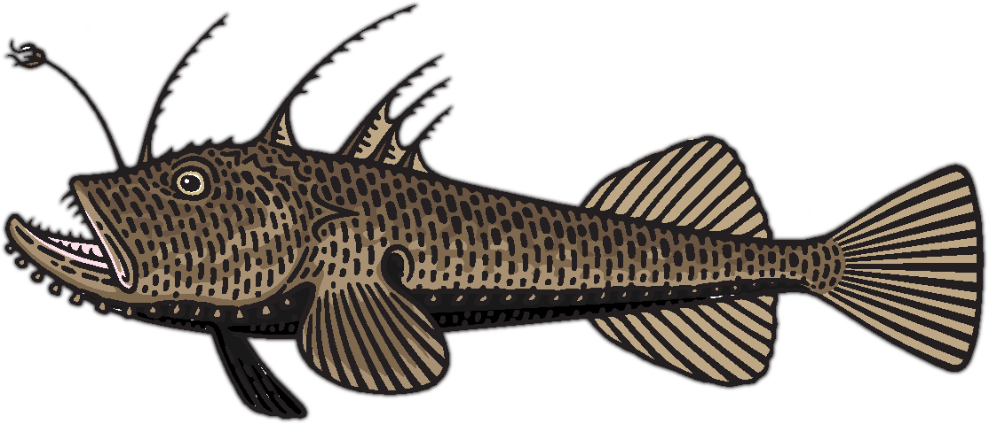
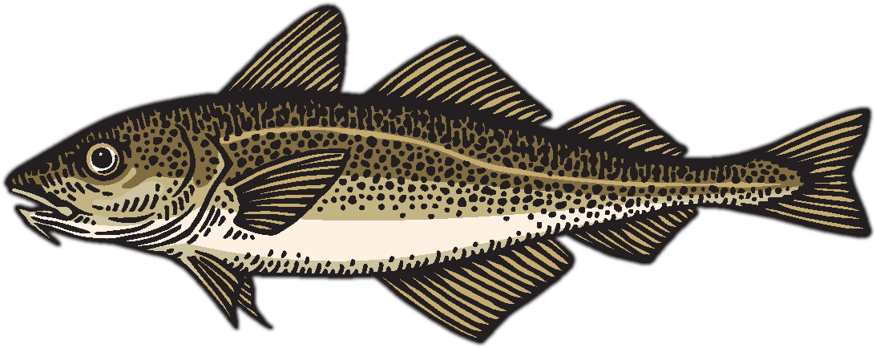
Notes:
We see strong correlation within these groups…..
Clustering these correlations, you see the same 3 groups highlighted on the left:
Flatfish
Deeper-water shelf species
Roundfish

Slide 17
Potential for spatial targeting
Notes:
What does this mean for the mixed fisheries ability to spatially separate chatches?

Slide 18
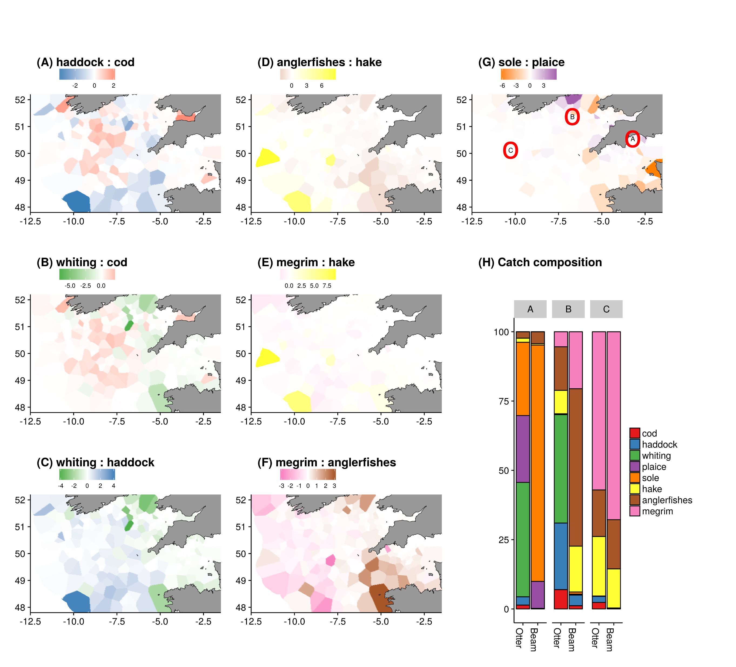
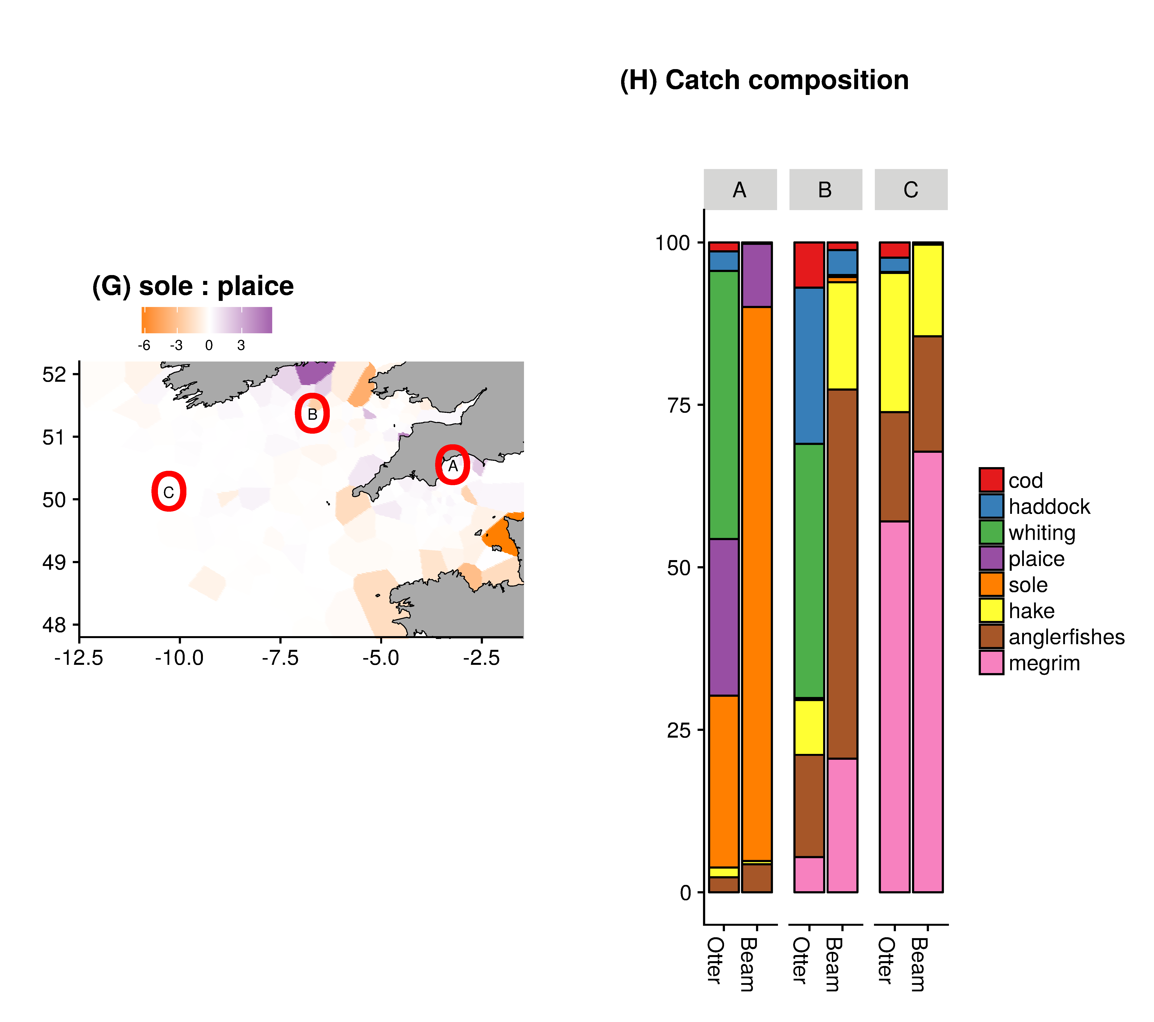
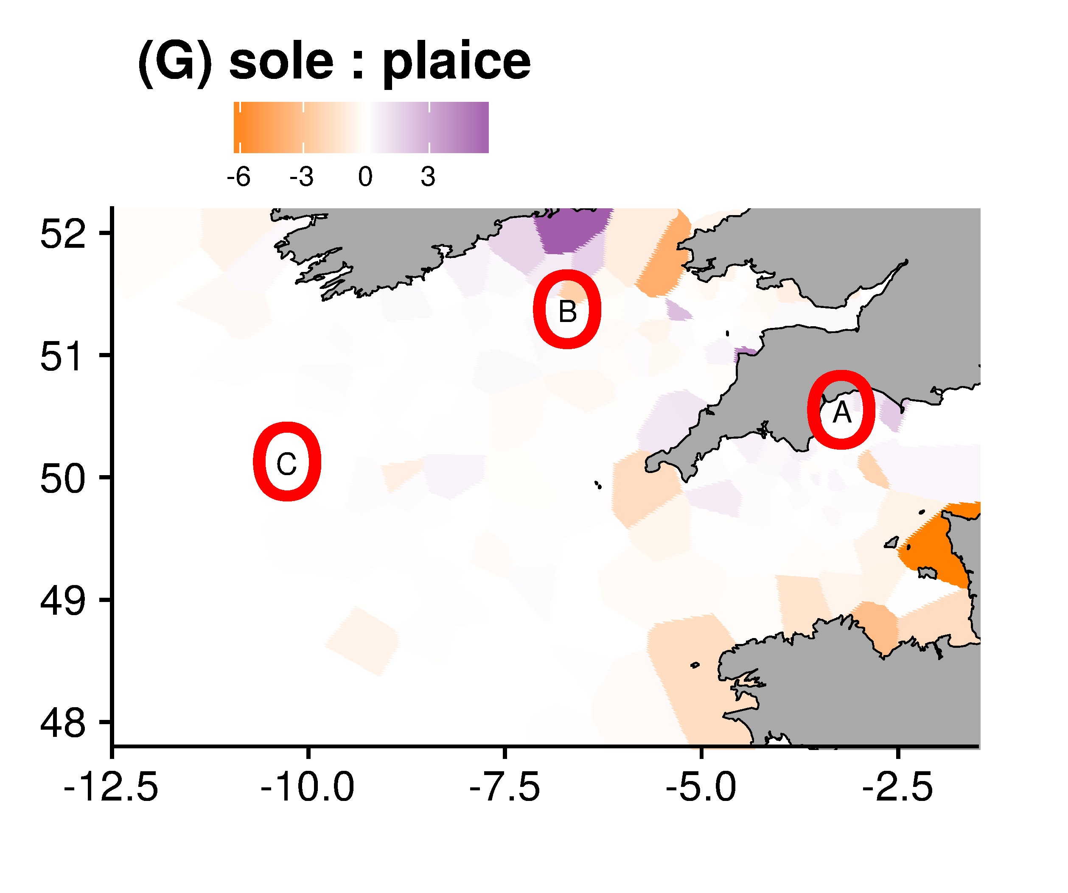
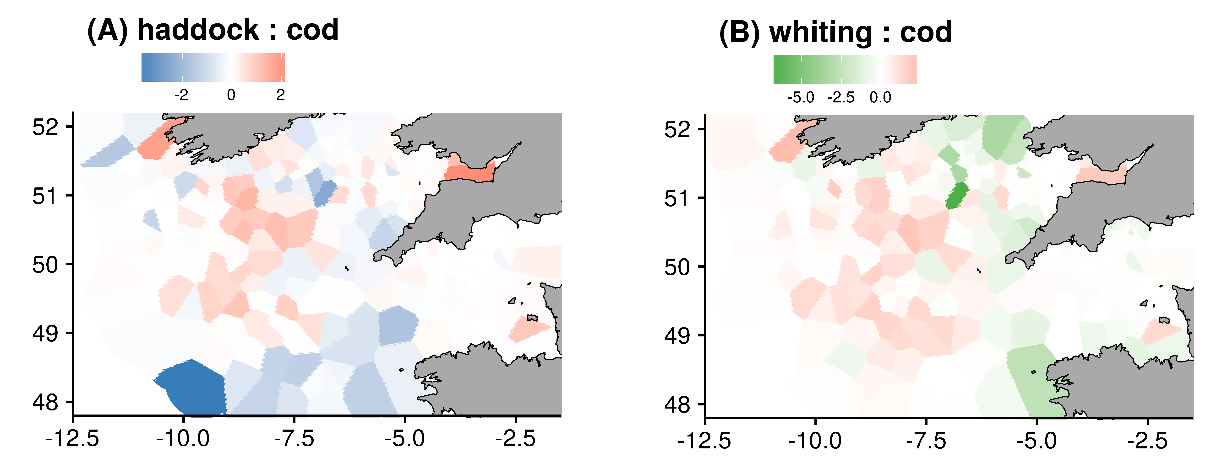
Notes:
Here, we have in the panels the differences in density among pairs of species. The groups are in the columns: roundfish, flatfish, deeper water shelf species.
If we zoom in on a couple of examples, you can see subtle differences in distribution of cod and haddock and cod and whiting. Haddock slightly more southernly distribution, whiting northerly and cod in the middle slightly further west,
We can predict catch composition for different points on the map. Can see that A) an inshore area results in more sole and plaice (depending on gear type, beam or otter) where more offshore (C) megrim, hake and anglerfishes dominate irrespective of the gear choice.
Nevertheless Interaction between gear and location important factor

Slide 19
Conclusions
Provides a dimension-reduction framework to understand how spatial community and fishery dynamics interact to determine species and size composition
Applied to the highly mixed fisheries of the Celtic Sea: clear common spatial patterns emerge for three distinct assemblages
Importance to focus management on axes of maximal separation and identify how spatial targeting can help support catch balancing
(modelling priority)
Notes:
So, to conclude:
We provide a dimension reduction framework to understand spatial community and fishery dynamics determine species composition in catch
Applied to Celtic Sea shows three species assemblages
Between assemblages easier to separate catches, within an assemblage more difficult
Need to emphasise maximal separation to identify where spatial targeting can help deliver the LO, or more generally help balance quota to fishing opportunities in mixed fisheries

Slide 20
BUT
Wasn’t what I came here initially to talk about….
Developing comparison of spatial effort allocation methods: RUMs, Markov, Dynamic state. Welcome a chat about your experiences
Also talk this afternoon on spatial simulation model: Spatial management and MPAs 3.30 PM – 5.00 PM

Slide 21




Thank you for listening!
Questions?
Contact: paul.dolder@gmit.ie
Spatial separation of catches in highly mixed fisheries. Scientific Reports (in review)
Acknowledgements:

